Slide 1
Data Structures and Algorithms
Lesson 5
Stacks

Slide 2
Stacks
Is a collection of items that exhibits the behaviour that the last item in is the first item out Last-in-First-out (LIFO).
Also consist of a linear or sequence of all insertions and deletion are made at one end, called top of the stack.

Slide 3
Stacks
Most essential linear data structure
A stack is a list in which insertion and deletion take place at the same end
This end is called top
The other end is called bottom
The most and least reachable elements are called “top” and “bottom”

Slide 4
Stacks
Stacks are known as LIFO (Last In, First Out) lists.
The last element inserted will be the first to be retrieved
e.g. a stack of Plates, books, boxes etc.

Slide 5
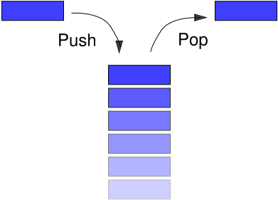
Insertion and deletion on stack

Slide 6
Stack Operation
push
The insertion (or addition) stacks operation. Pushing an element to a stack will add the new element at the top.
After every push operation the top is incremented by one. If the array is full and no new element can be accommodated, then the stack overflow condition occurs.

Slide 7
Operation On Stack
Creating a stack
Checking stack---- either empty or full
Insert (PUSH) an element in the stack
Delete (POP) an element from the stack
Access the top element
Display the elements of stack

Slide 8
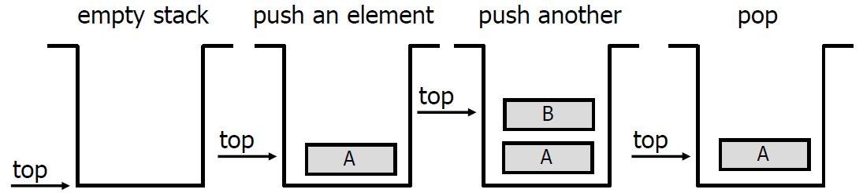
Push and Pop
Primary operations: Push and Pop
Push
Add an element to the top of the stack.
Pop
Remove the element at the top of the stack.

Slide 9
Stack-Related Terms
Top
A pointer that points the top element in the stack.
Determines its current position
Has value 0 when its empty
Stack Underflow
When there is no element in the stack, the status of stack is known as stack underflow.
Stack Overflow
When the stack contains equal number of elements as per its capacity and no more elements can be added, the status of stack is known as stack overflow

Slide 10
Representation of Stacks

Slide 11
Stack Implementation
Implementation can be done in two ways
Static implementation
Dynamic Implementation
Static Implementation
Stacks have fixed size, and are implemented as arrays
It is also inefficient for utilization of memory
Dynamic Implementation
Stack grow in size as needed, and implemented as linked lists
Dynamic Implementation is done through pointers
The memory is efficiently utilize with Dynamic Implementations

Slide 12
Static Implementation
Elements are stored in contiguous cells of an array.
New elements can be inserted to the top of the list.
top
First Element
Second Element
List
Last Element
Empty
maxlength

Slide 13
Static Implementation
1
2
3
2
1
2
1
1
Problem with this implementation
Every PUSH and POP requires moving the entire array up and down.

Slide 14
Stack Operation (continued)
Pop
The deletion (or remove) stacks operation. After every pop operation top of the stack is decremented by one.
If there is no element in the stack (empty stack) and the pop operation is performed then the stack underflow condition occurs.

Slide 15
Top
Top is a place where insertion and deletion takes place. Collection of data items can only be accessed in this location.

Slide 16
Stack Implementation
Static
Using array
Dynamic
Using linked list

Slide 17
Static Implementation
Since, in a stack the insertion and deletion take place only at the top, so…
A better Implementation:
Anchor the bottom of the stack at the bottom of the array
Let the stack grow towards the top of the array
Top indicates the current position of the first stack element.

Slide 18
Static Implementation
A better Implementation:
top
1
2
First Element
Second Element
.
.
maxlength
Last Element

Slide 19
Push algorithm
1. If TOP = SIZE – 1, then:
(a) Display “The stack is in overflow condition”
(b) Exit
2. TOP = TOP + 1
3. STACK [TOP] = ITEM
4. Exit

Slide 20
Pop algorithm
1. If TOP < 0, then
(a) Display “The Stack is empty”
(b) Exit
2. Else remove the Top most element
3. DATA = STACK[TOP]
4. TOP = TOP – 1
5. Exit

Slide 21
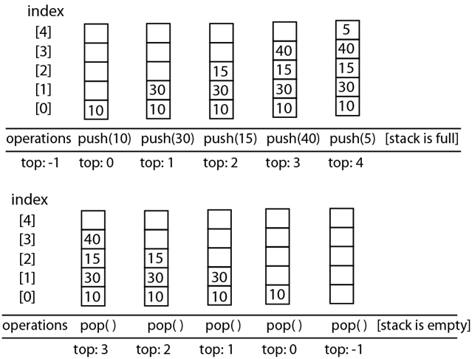
Stack Example

Slide 22
Stack Implementation (array)
#include <iostream>
#define STACK_SIZE 5
using namespace std;
int stackNum[STACK_SIZE];
int top=-1;
void pop();
void push(int);
void display();

Slide 23
Stack Implementation (continued)
int main()
{
while(1){
int choice,num;
system("cls");
cout<< "[1] - Push \n";
cout<< "[2] - Pop \n";
cout<< "[3] - Display \n";
cout<< "[4] - Exit \n";
cout<< "\n====================\n";
cout<< "Enter your choice: ";
cin>> choice;

Slide 24
Stack Implementation (continued)
switch(choice){
case 1:
cout<<"Enter number to push: ";
cin>>num;
push(num); break;
case 2:
pop(); break;
case 3:
display(); break;

Slide 25
Stack Implementation (continued)
case 4:
exit(1);
default :
cout<<"\nInvalid Choice";
}
cout<<endl<<endl;
system("pause>0");
return 0;
}

Slide 26
Stack Implementation (continued)
void pop()
{
if(top==-1)
cout<<"\nStack is Empty\n";
else
cout<<"You remove " << stackNum[top--];
}

Slide 27
Stack Implementation (continued)
void push(int n)
{
if(top==STACK_SIZE-1)
cout<<"Stack is full";
else
stackNum[++top]=n;
}

Slide 28
Stack Implementation (continued)
void display()
{
if(top==-1)
cout<<"\nstack is empty\n";
else
for(int i=top;i>=0;i--)
cout<<stackNum[i]<<endl;
}

Slide 29
Infix, Prefix, and Postfix
Infix notation
Operator is written in-between the operands.
ex:
x+y
x+y*z
(x+y)*z
(x+y)*(p+q)

Slide 30
Infix, Prefix, and Postfix
Prefix notation
polish notation
Operators is written before the operands
ex:
+xy
+x*yz
*+xyz
*+xyz+pq

Slide 31
Infix, Prefix, and Postfix
Postfix notation
Reverse polish notation
Suffix notation or reverse polish notation
Operators is written after the operands
Ex:
xy+
xyz*+
xy+z*
xy+pq*+

Slide 32
Operator Precedence
^ - Exponential operator
*, / - Multiplication, Division
+, - - Addition, Subtraction

Slide 33
Sample Problem
Given the expression A + B * C
Solve the infix, prefix and postfix

Slide 34
Solution
Infix
A + B * C

Slide 35
Solution
Prefix
A + (B * C) parenthesized the expression
A + (* B C) convert the sub expression to prefix (multiplication)
+ A (* B C) convert to prefix (addition)
+ A * B C remove the parenthesis

Slide 36
postfix
A + (B * C) parenthesized the expression
A + (B C *) convert the sub expression to postfix (multiplication)
A (B C *) + convert to postfix (addition)
A B C * + remove the parenthesis

Slide 37
Seat Work
Give the prefix and postfix form for
1 + 2 * 3 ^ 4 / 5 – 6
Give the prefix and postfix form for
A + ( (B + C) + (D + E) * F) / G

Slide 38
Answer
1 2 3 4 ^ * 5 / + 6 – postfix form
A B C + D E + F * + G / + postfix form

